Slide 1
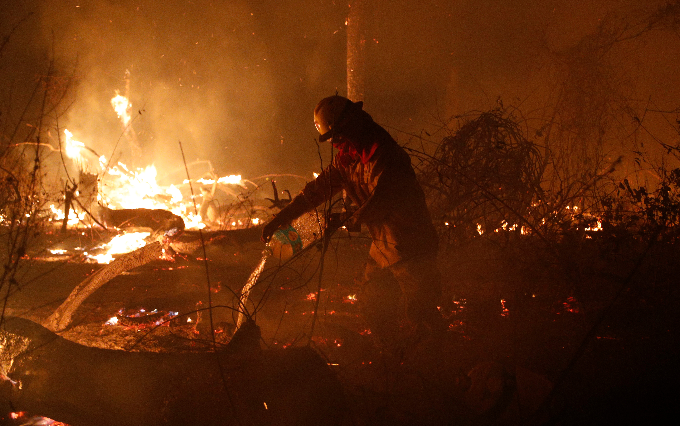

Amazon Rainforest Fires
Right now communities of the Amazon need your solidarity
Bolivia: Over 2,700 fires have ravaged more than 744,000 hectares of land affecting over 1,800 families.
Brazil: Over 72,000 fires detected, the highest since records began.
Indigenous communities of the Amazon are paying the highest price. Please
Pray for them
Sign our petition to the UK Prime Minister
Find out more at caid.org.uk
Photo: Steve Chirombo / Christian Aid
Notes:
.

Slide 2
Prayer for those affected
Creator God,
When the fires rage
and the flames engulf us,
Who can we turn to but you?
We cry out to you now,
For the sake of the Amazon;
the lungs of the earth.
We pray for your protection
and divine restoration.
Loving God,
We ask for you to bring life and hope
where there is destruction and death;
for our indigenous sisters and brothers
who call the rainforest home.
We repent for taking for granted
your wondrous creation,
for plundering its resources
to satiate our own greed.
For not paying enough attention.
We pray for a change of heart for governments who have the ability to make change.
Give us the courage to stand in solidarity
with those whose voices go unheard.
Give us the hearts to stand up
for all those made in your image.
In your name we pray.
Amen

Slide 3
Stand in solidarity with the Amazon
Over 1000 church denominations and faith-based organisations worldwide have joined forces to support the “Somos la Amazonia” declaration by churches in the Amazon region. The declaration will be presented at the Synod of Bishops for the Pan-Amazon region in October 2019, to help strengthen the faith movement for the protection of the Amazon. Christian Aid is reaching out to faith-based organisations globally to seek their endorsement of the declaration.
You can read the declaration, which you may want to use for your own reflection and prayer.
Notes:
https://actalliance.org/wp-content/uploads/2019/08/CartaSomosLaAmazonia_eng.pdf

