Slide 1
East Africa Hunger Crisis
Appeal

Slide 2
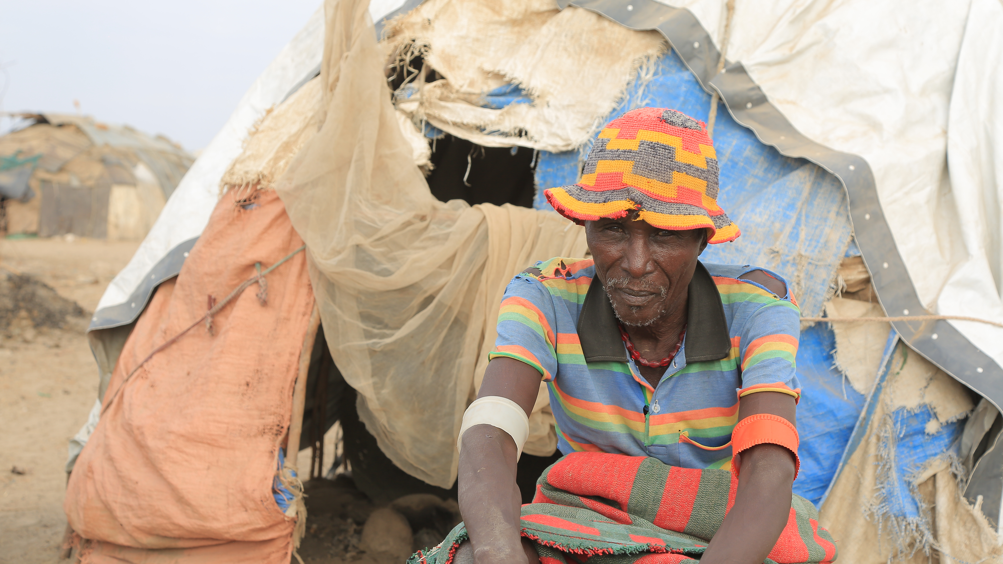
Adoko Hatoro Engang, a pastoralist famer in South Omo, Ethiopia, outside his temporary home.
Photo: Christian Aid/Meseret Abiy

Slide 3
East Africa Hunger Crisis
East Africa is facing the worst drought in 40 years after four consecutive failed rainy seasons.
18.4 million people in Kenya, Ethiopia and Somalia are missing meals, or eating a less diverse diet. Women and girls are particularly affected.
People are taking desperate measures to survive. More than one million have abandoned their homes in search of food, water and pasture for livestock.

Slide 4
The situation
The severe weather is being made worse by the climate crisis.
With the war in Ukraine causing global food prices to rocket, we are facing a crisis on crisis.

Slide 5
Christian Aid’s response
Christian Aid is helping more than 300,000 people with safe, clean water
We’re providing water purification kits and repairing wells.
Animal feed and medicine is being distributed to keep valuable livestock alive.

Slide 6
Prayer for East Africa
Loving and compassionate God,
When famine stalks the land, nothing grows.
Plants cannot, people cannot,
ideas and dreams cannot.
Everything withers and dies.
It is a violent aberration of your will for the world
and it is multiplied now
by conflict, climate change and Covid.

Slide 7
Prayer for East Africa
God of the flourishing field,
there is enough to feed us all.
Call us to that sacred sharing,
neighbour to global neighbour.
Your gifts of food, water,
a chance to live the life so delicately crafted
by your divine spirit.

Slide 8
Prayer for East Africa
We will not turn away, but turn towards each other,
with generosity and a justice-driven compassion
that searches for solutions.
Famine stalks the land, so may our outrage grow,
may our determination steel itself,
may our solidarity spur us into action.

Slide 9
Prayer for East Africa
God of the flourishing field,
help us feed each other.
Amen.

Slide 10
Please
donate today
caid.org.uk/eastafricaappeal

Slide 12
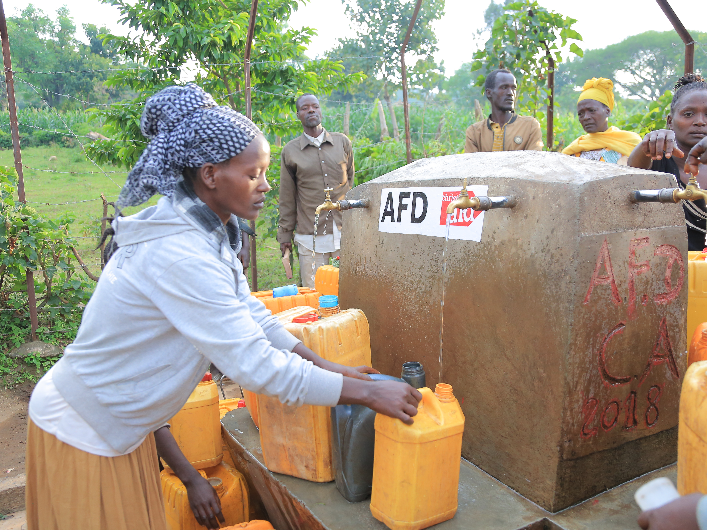

Slide 13
