Slide 1



Modern Day Slavery Workshop
Helen Howe, Salt Project Manager
Matti Kohonen, Private Sector Policy Advisor

Slide 2
Workshop Agenda
Welcome / Introductions / Reflection
Overview: Modern Day Slavery
Discipleship Challenges: Leading Change
Break & Networking
Discipleship Challenges: Provoking a Community of Change
Overview: The incubator fund Discipleship challenges: resourcing change Salt pledges & feedback AOB & Closing prayer
4.00-4.15pm
4.15-4.45pm
4.45-5.25pm
5.50-6.20pm
6.20-6.50pm 6.50-7.00pm

Slide 3
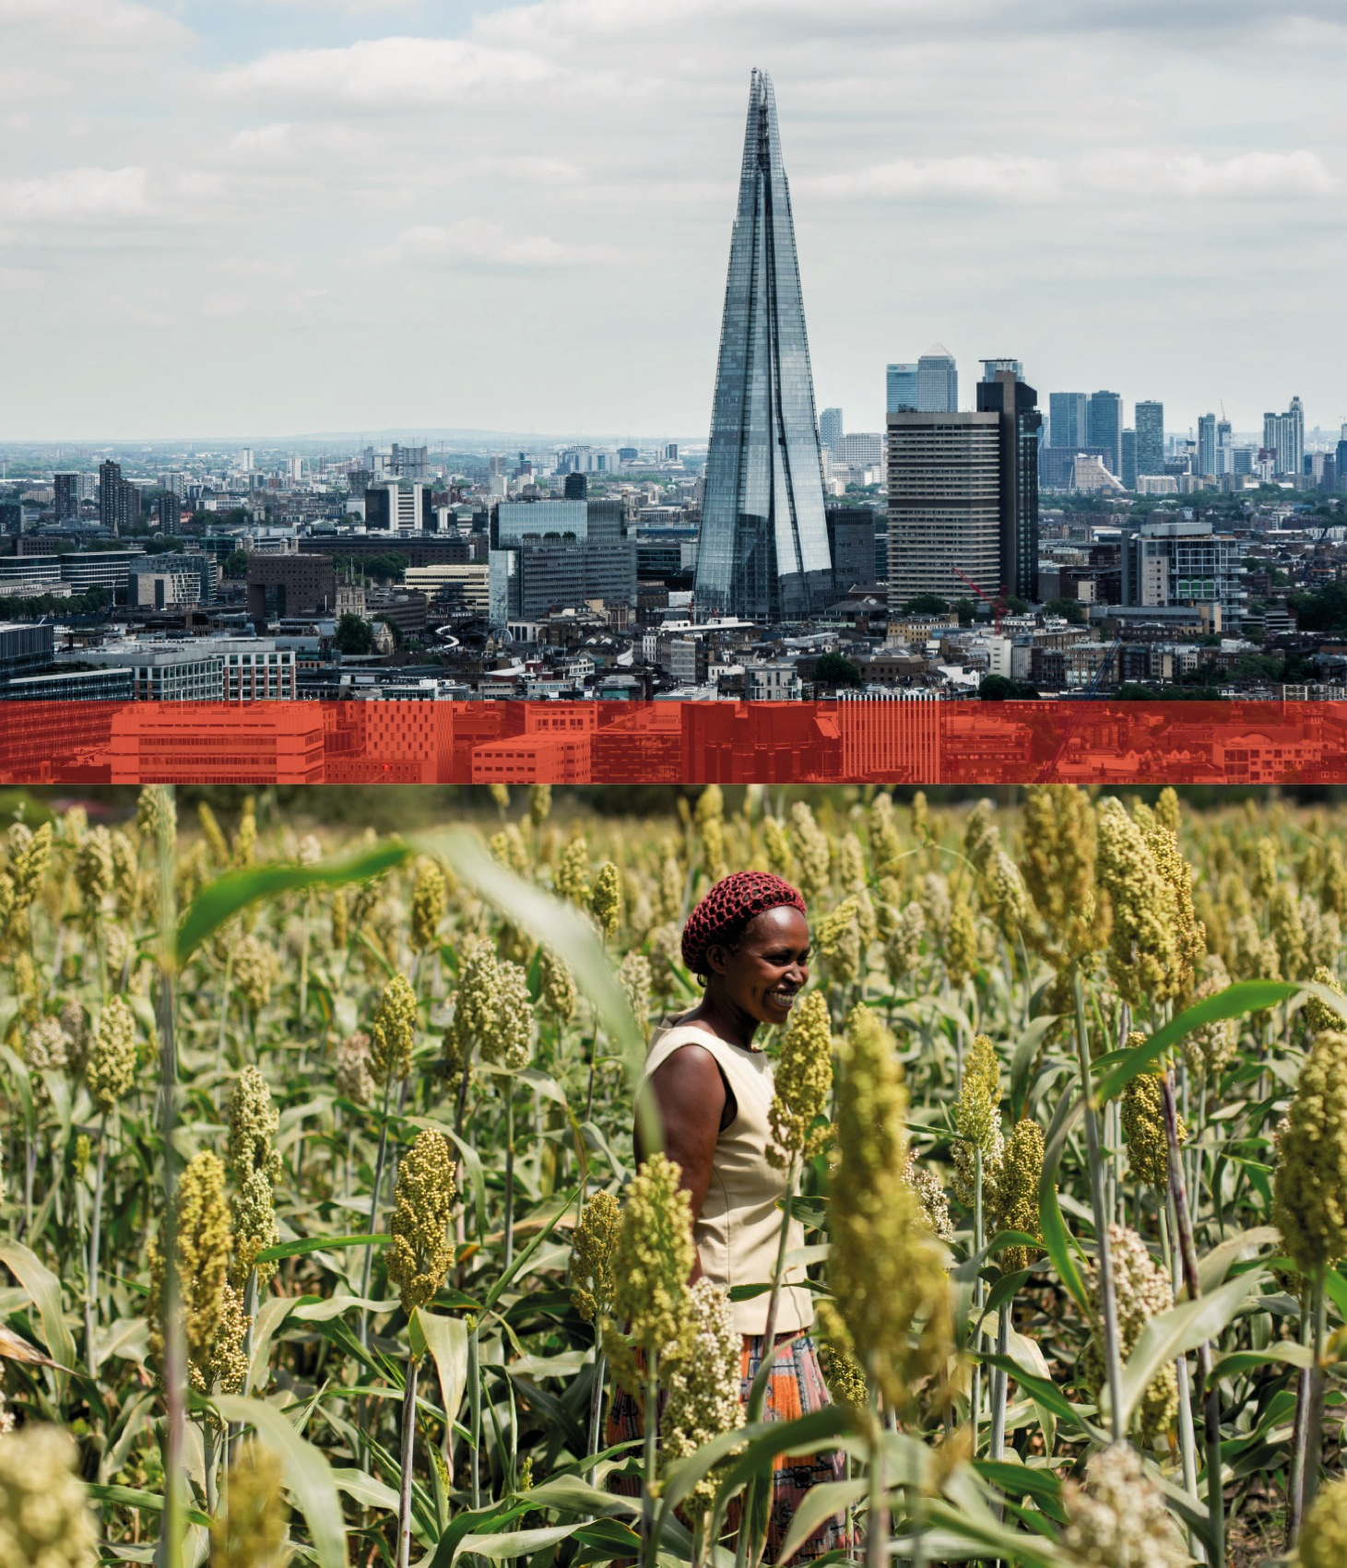
Welcome
Introductions

Slide 4
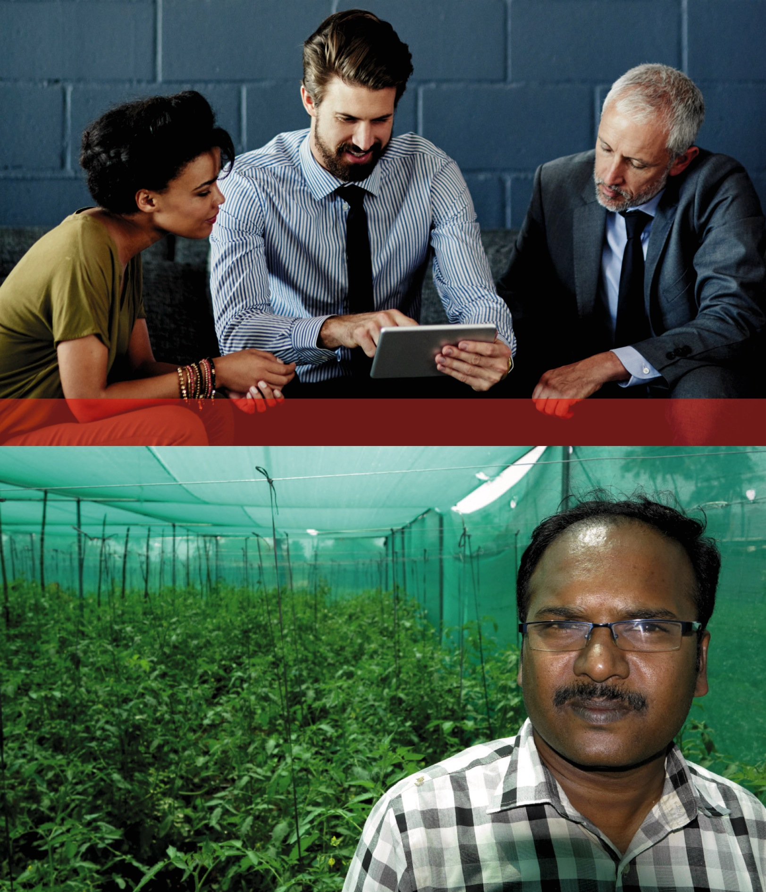
Ground Rules

Slide 5
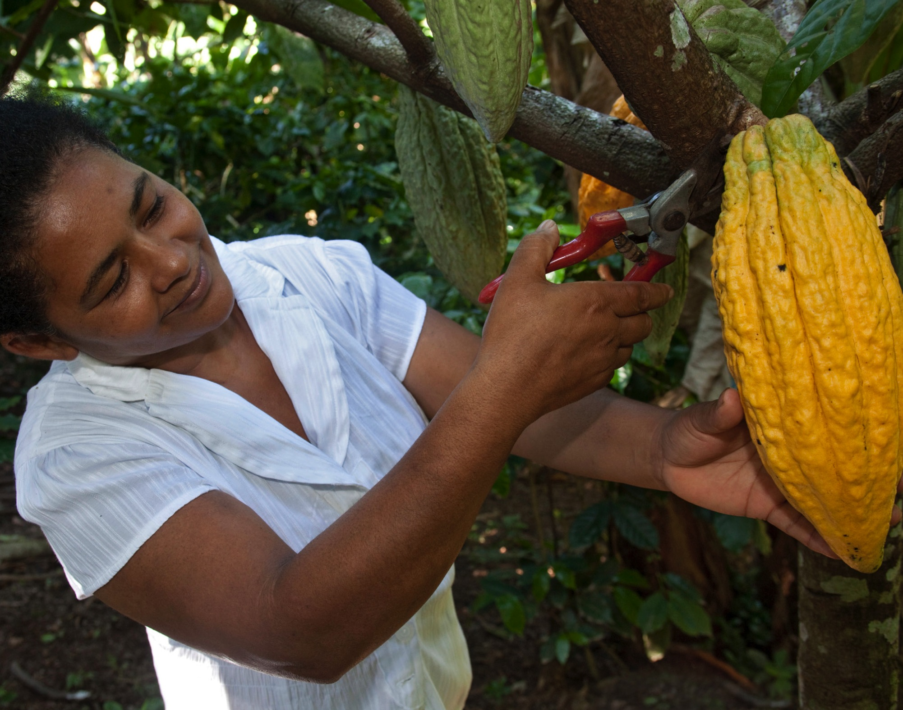
Reflection
Notes:
Julia Howl

Slide 6
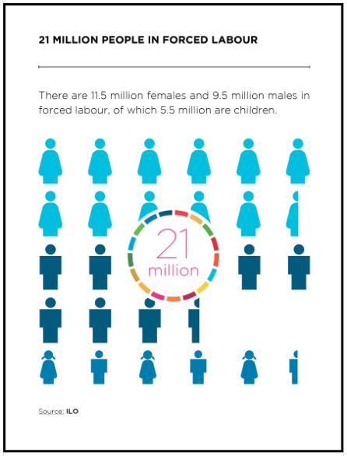
Modern Day Slavery: An Overview
Notes:
One of the most discussed human rights issues of our time. Affects 2.4 million people at any given moment.
Estimated that 21 million people are living in forced labour conditions, of which 14.2 million of those working in forced labour are in the private sector.
UK’s Modern Slavery Act and the duty it places on businesses to disclose publicly the steps they are taking to tackle forced labour and human trafficking.
Huge issue but "Nobody ever made a greater mistake than he who did nothing because he could do only a little". Edmund Burke – Just like JL – start somewhere and do a little more each year. Start with highest risk

Slide 7
How come slavery still happens?
People who are poor, and also poorly educated and unskilled, tend to be most at risk of becoming trapped in slave labour
Risks are particularly high in kinds of work requiring low levels of education, for example unskilled work in agriculture, fishing, domestic work, manufacturing, and the informal sector generally
44% of people trapped in slave labour are migrants

Slide 8
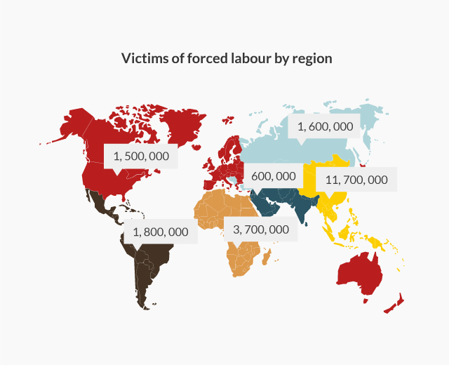
Global Issue
Notes:
Mention Case studies

Slide 9
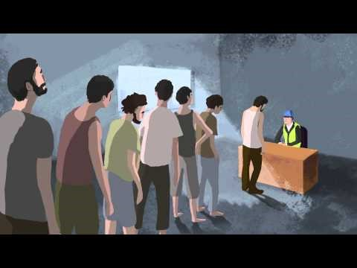
What is modern slavery?
International Labour Organisation: https://www.youtube.com/watch?v=sOHq0MlN3PY
Notes:
https://www.youtube.com/watch?v=sOHq0MlN3PY

Slide 10

ILO indicators of forced labour
Abuse of vulnerability
Deception
Restriction of movement
Isolation
Physical and sexual violence
Intimidation and threats
Retention of identity documents
Withholding of wages
Debt bondage
Abusive working and living conditions
Excessive overtime
10
Notes:
2 x Buckets. One bucket is marked modern slavery and should have a lid. The other is marked exploitation. Trainer explains how slavery equals a lack of freedom. Once the worker is inside the modern slavery bucket, it is very hard to get out. Trainer puts the lid on to emphasise this point. Worker may be in a situation of extreme exploitation, but if they have a realistic option of leaving, then it is not modern slavery.

Slide 11
How come slavery still happens?
People who are poor, and also poorly educated and unskilled, tend to be most at risk of becoming trapped in slave labour
Risks are particularly high in kinds of work requiring low levels of education, for example unskilled work in agriculture, fishing, domestic work, manufacturing, and the informal sector generally
44% of people trapped in slave labour are migrants

Slide 12
Modern Day Slavery: Response
Modern Day Slavery Act 2015 Corporate Human Rights Benchmark (CHRB) UN Guiding Principles on Human Rights Reporting Framework EU Social and Environmental Reporting Regulations UN Sustainable Development Goals
Notes:
MDS Act: From October 2015, companies who earn £36m or more need to produce an annual slavery and trafficking statement, outlining the steps they have taken to ensure there is no modern slavery in either their supply chain or their own operations. The law applies to at least 12,000 companies based in the UK, and a further 5,000 international firms with UK operations who meet the revenue threshold.
Corporate Human Rights Benchmark (CHRB) - 500 of the top global companies from four key sectors – Agriculture, ICT, Apparel, and Extractives – will initially be researched and ranked.
UN Guiding Principles on Human Rights Reporting Framework - Investors’ preferred reporting framework for Human Rights.
EU Social and Environmental Reporting Regulations - Will apply to listed companies with more than 500 employees (estimated at 6,000 within the EU) by 2016.
UN Sustainable Development Goals - Goal 8 includes: Take immediate and effective measures to eradicate forced labour, end modern slavery and human trafficking and secure the prohibition and elimination of the worst forms of child labour, including recruitment and use of child soldiers, and by 2025 end child labour in all its forms.

Slide 13
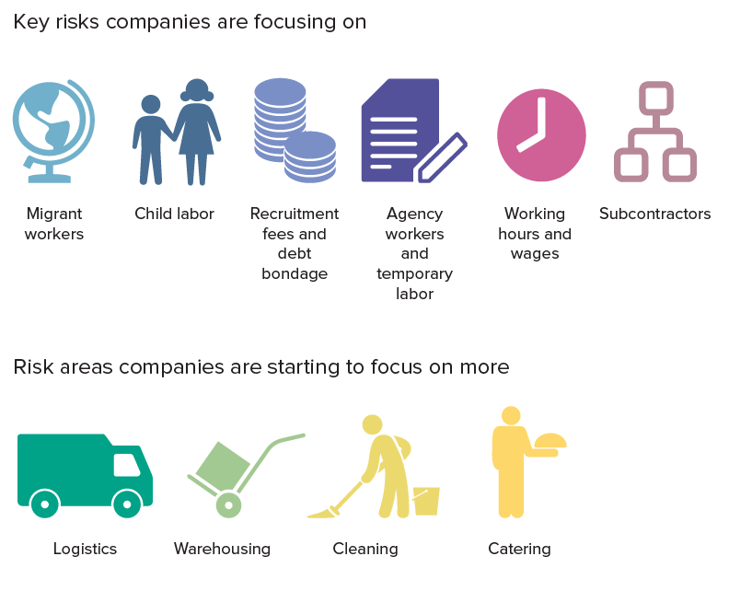
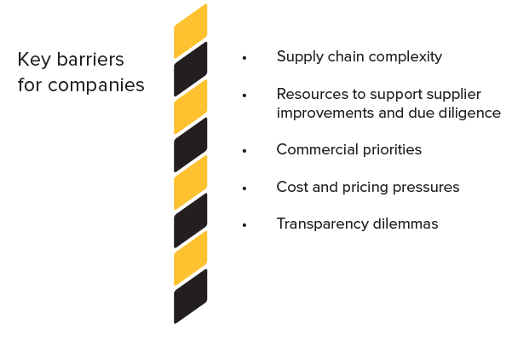
Key risk areas for companies
Key barriers for companies

Slide 14
The Modern Slavery Act has been a game changer
Seeing lots of action in companies since UK Act was introduced:
Twice as many CEOs actively involved
Training and awareness for board members (67%)
Carrying out risk assessments (45%)
Policies & systems to manage approach (39%)
Increased communication with suppliers – tier 1, 2 and beyond
Collaborating with peers, incl. specific projects and initiatives

Slide 15
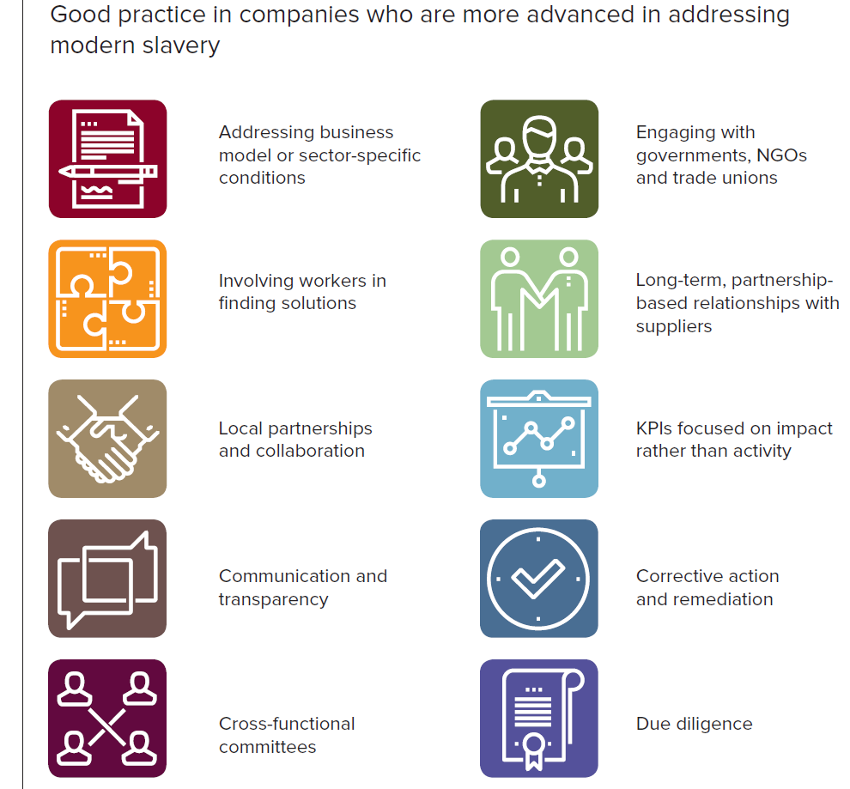
What does good look like?

Slide 16
Discipleship Challenges: Leading Change: Examples
Commit to review 3 most important purchases
Build staff awareness on Modern Day Slavery issues
Commit to review 3 most important purchases
Improve supply chain transparency by publishing your 10 top suppliers
Review standard contracts with all suppliers
Assess risk related to subcontractors
Influence internally by raising questions

Slide 17
Breakout Session (25min)
- Have you looked at this in your business already?
- Is there any lessons that you can share?
- If you haven’t undertaken this kind of challenge before, what support do you think you might need?

Slide 18
Feedback & Personal Pledge

Slide 19
Discipleship Challenges: Provoking a community of change
Raising awareness of MDS issues
Raising awareness of
Salt network
Through 1 to 1 conversations
Through 1 to 1 conversations
Through networks
Through networks
Through lobbying: either on my own or with others

Slide 20
Feedback & Personal Pledge

Slide 21
Breakout Session (15min)
Looking at each challenge
- how could we approach it?
- who could we involve?
- How can we maximise the impact?
- What support can Christian Aid give you?

Slide 22
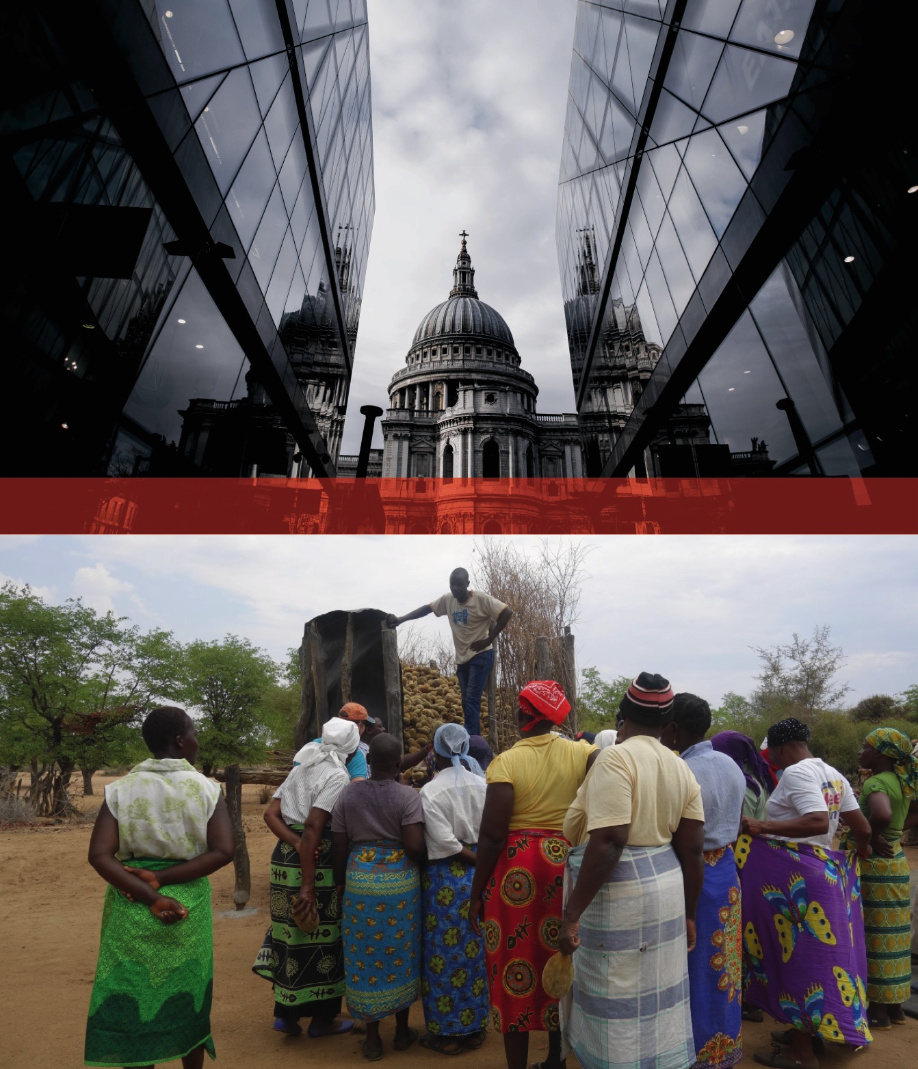
Inclusive Business Programme Strategy
Our aim is…
To support businesses to grow and increase their social impact, and to help achieve Christian Aid’s Strategic Change Objectives, either
by finding entrepreneurial models of achieving impact
or by helping businesses towards self-sustaining business models

Slide 23

Inclusive Business
Programme
What help does it need to become ‘investible’?
Technical Assistance and Business Development Support
Enterprise growth leading to achievement of Strategic Change Objectives
Can it be a viable business?
Key enterprises identified
Impact Investment
Incubation Programme
Direct or Introduced to external ‘patient’ investors (£100k+)?
Does it need support to meet ACRE criteria
Programmes
Can this business help achieve programme goals?
Notes:
Incubator investment enables small and medium businesses to make a qualitative jump in order to reach a point where they are an attractive and viable well managed and administered business with clear growth milestones to attract external funding or access credit.
The decision to invest incubator funds in each business is taken on the basis of a sound assessment of the business plans and proposals undertaken by a committee of ACRE delegates,, staff from the Christian Aid programme, and an expert from the sector who works for the business.
Once the incubator money is transferred, which could take the form of a grant or in some situations a loan, Christian Aid and the ACRE team will continue to undertake close financial monitoring each month and also will continually assess the social impacts being generated by the investment to ensure that the technical support is effective in generating opportunities within the business to be a catalyst within an inclusive market system that promotes social and economic equity.

Slide 24
Inclusive Business Programme Strategy
Four Focus Areas:
Impact Investment - ACRE
Incubation – Incubator Fund / Social Enterprise Fund
Business Support
Impact, Learning and Business Enabling Environment
Anticipated Impact:
The projected impact for the next 3 years would be to directly support 50
enterprises and buy from or provide services to in excess of 60,000
producers or consumers (this is an early estimate and will vary depending
on the enterprises selected).
Notes:
On average costs around £5k to get a business investor ready

Slide 25
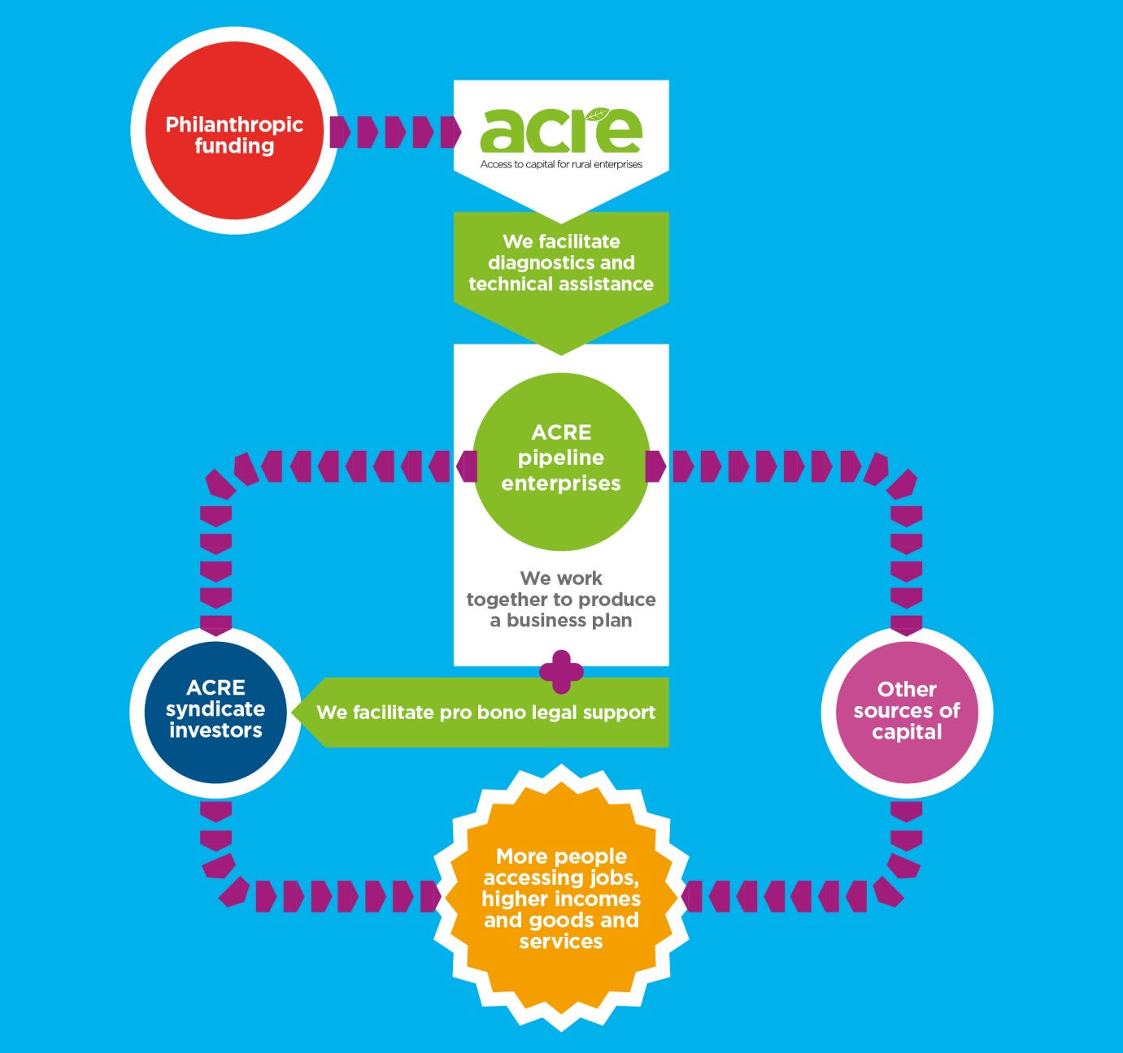




ACRE AT A GLANCE
215 enterprises identified
31 enterprises evaluated
19 enterprises supported
8 business plans ready
4 enterprises pitched

Slide 26
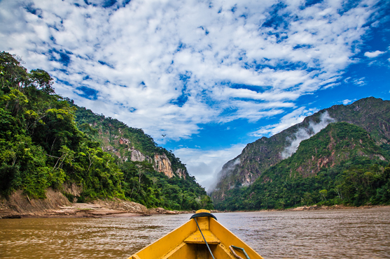

Slide 27
Incubator fund: Case Study
Country: Bolivia
Business focus: Eco- Tourism, Wildlife, Nature Reserve Size: 6 Full-time employees (1 female)
Chalalán S.A. is a community-owned ecotourism company located in the heart of the Madidi National Park in the Bolivian Amazon
Chalalán targets national and international mid and high income tourists looking for a premium experience in the wilderness.
Average 700 visitors a year
Revenue USD $350k

Slide 28
Incubator fund: Case Study
Impact Highlights
Direct Impact: 633 indigenous people in the community of San José de Uchupiamonas
1) Promotion of indigenous land rights by funding the process of the Community Land of Origin (TCO)
2) Job opportunities for the local indigenous community of San José de Uchupiamonas
3) 50% of profit is returned to the community of San José de Uchupiamonas for social benefit use and sustainability
4) Promotion of green energy and recycling as well as awareness raising in conservation of nature and bio-diversity

Slide 29
Incubator fund: Case Study
Strategic objectives
Achieve operational efficiency and understand and have absolute control of financial information, as well as pay off unpaid tax debts by previous administrations.
Marketing, in order to improve communications and be able to communicate to its market segment and also to differentiate it from its competitors.
Investing in Human Resources that contribute to achieve the operational enhancement and the growth strategy.
Capital investment is needed to make some improvements in infrastructure and maintenance, and to support the operational enhancement strategy.
Working capital to run the business and cover a tax liability provision.

Slide 30
Discipleship Challenges: Resourcing Change
Financial support to incubator fund
Use of skills & expertise
Prayer

Slide 31
Feedback & Personal Pledge

Slide 32
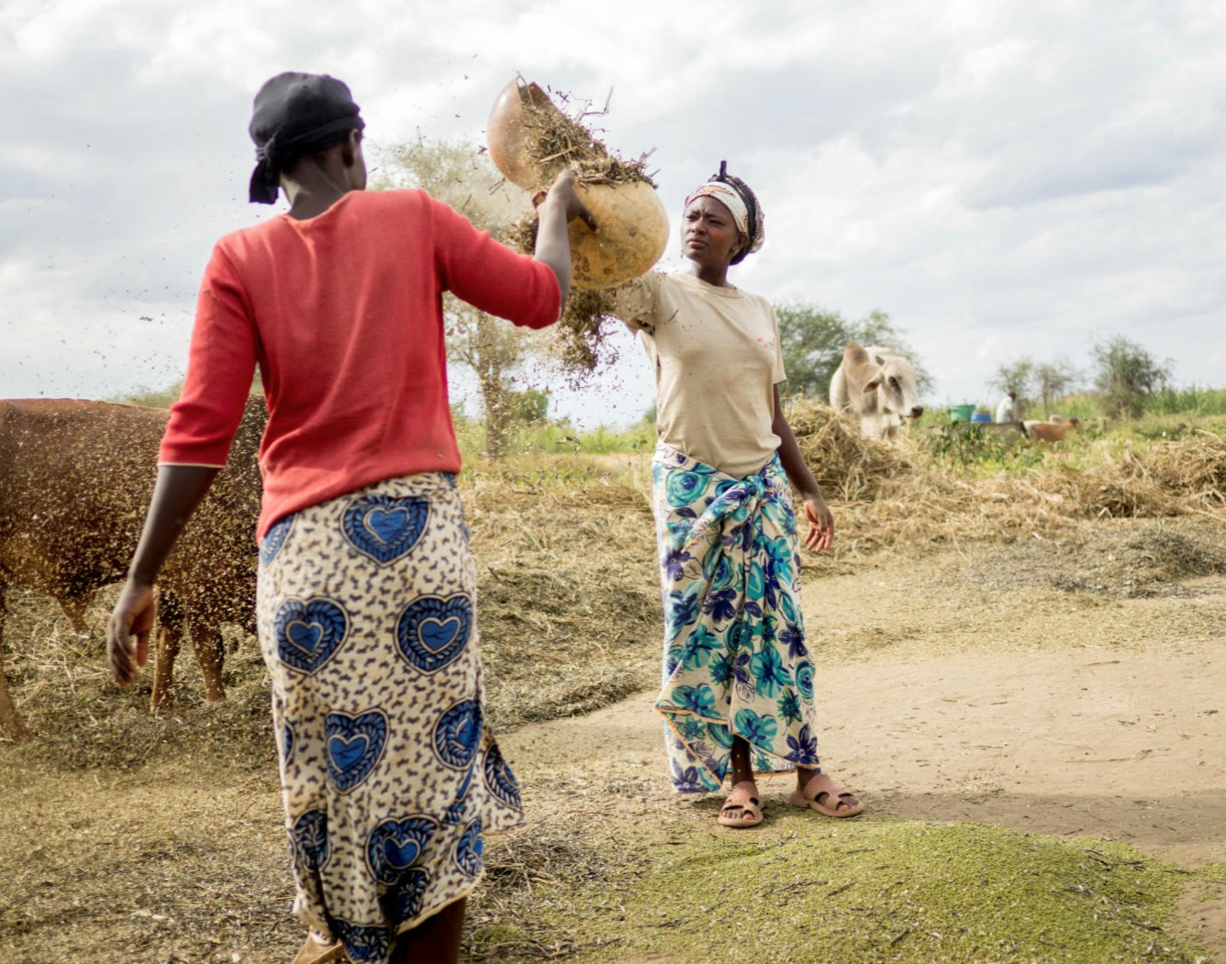
AOB & Closing Prayer
Notes:
Heavenly Father, We pray for those whose work isn’t creative or enjoyable but demeans and enslaves them. We pray for those in the UK in work gangs whose masters don’t adhere to UK employment law and who exploit powerless people. We pray for people in developing countries, especially children, who work in places where attention to safety is poor and conditions are dangerous. Help us as consumers to be wise and to care – how our clothes are made and our food is grown; make us willing to pay enough to enable fairness and respect to be part of every worker’s experience. Help us to love others as we love ourselves.
Pray for Salt members
Pray for Eco lodge in Bolivia

Slide 33
